Slide 1

Style Transfer for Videos with Audio
Gaurav Kabra, Pooja Yadav, Priyanshu Singh
2016ucp{1471, 1406, 1393}
B.Tech. Final Year Project

Slide 2


About Our Project
Has been selected by International Conference on Paradigms of Computing, Communication and Data Sciences (PCCDS-2020) to be published by Springer, to be held during 01- 03 May 2020 at the NIT Kurukshetra
Focuses on Deep Learning concepts, Computer Vision and CNN

Slide 3
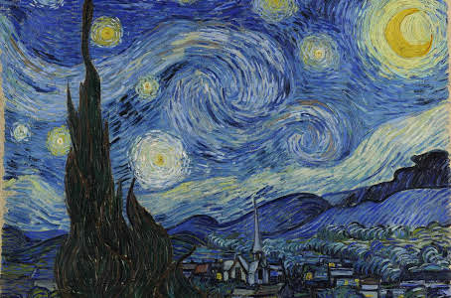
Motivation
From early days of human evolution, paintings with content from surrounding but style (like color and texture) from imagination are being developed.
Starry Night by famous painter von Gogh is one such example.
Fig. : Houses, mountains and moon are from real world but notice their filling is from painter's imagination

Slide 4
Style Transfer (a.k.a Deep Harmonization)
The problem of taking content of an image and style of other image to create third image having content of the former but style of the latter
Such work cannot be obtained by simple overlapping the two images

Slide 5
Why developments in this field started only recently?
Only till few years back, due to under-optimized GPUs and slower hardware, image processing was a time consuming computation problem
Only recently we can use technological optimizations to use Convolutional Neural Networks (CNNs) to do the Style Transfer

Slide 6
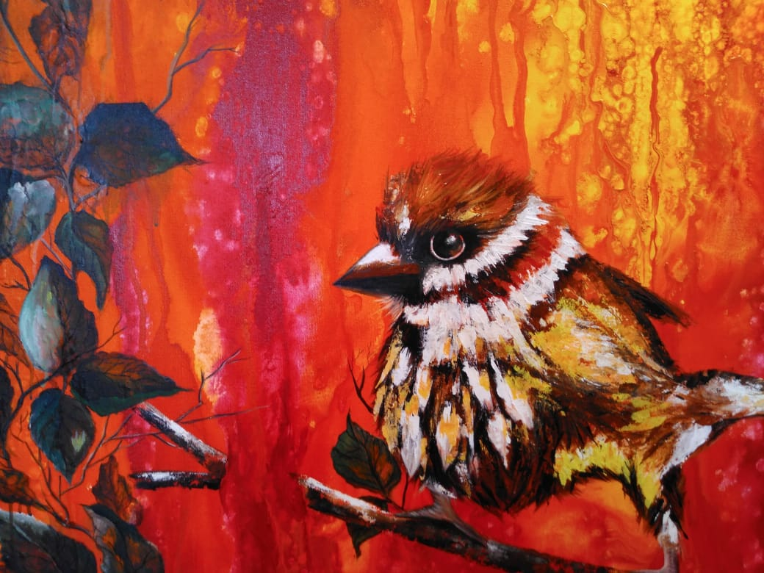
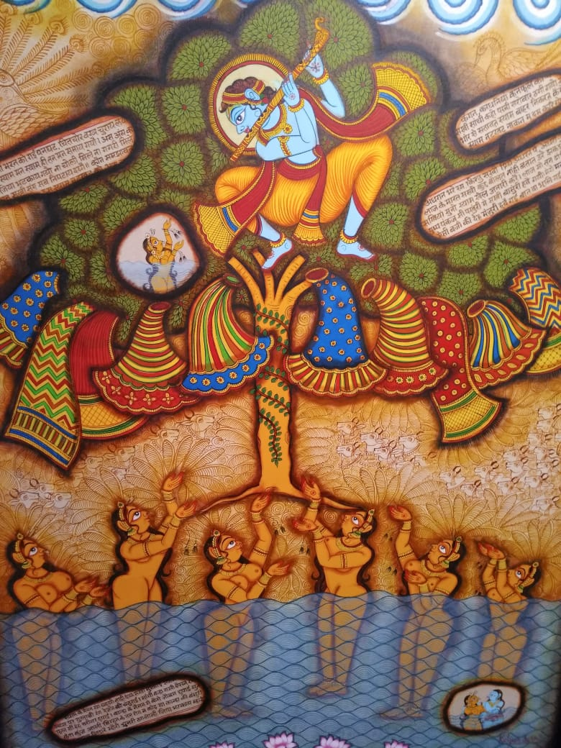
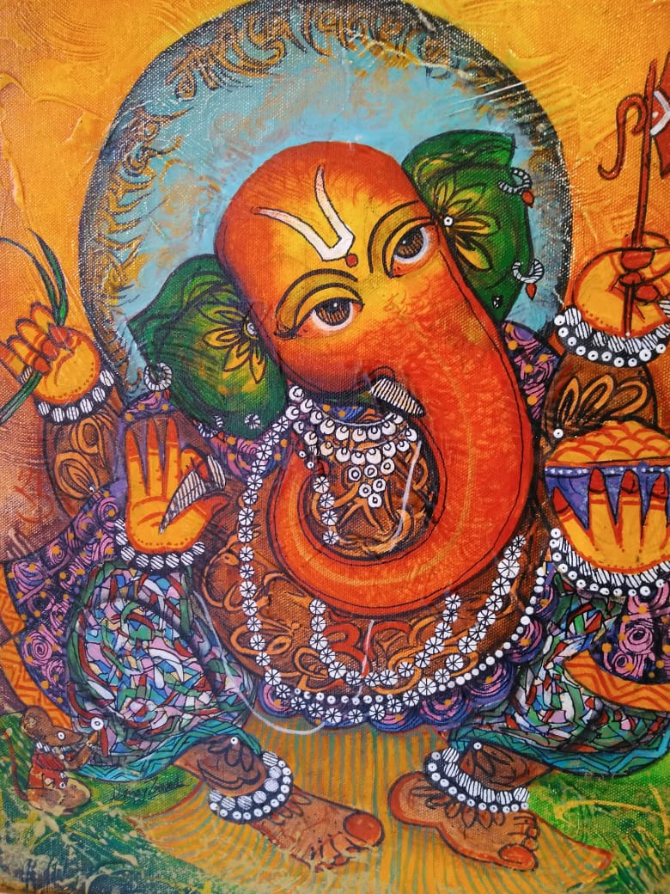
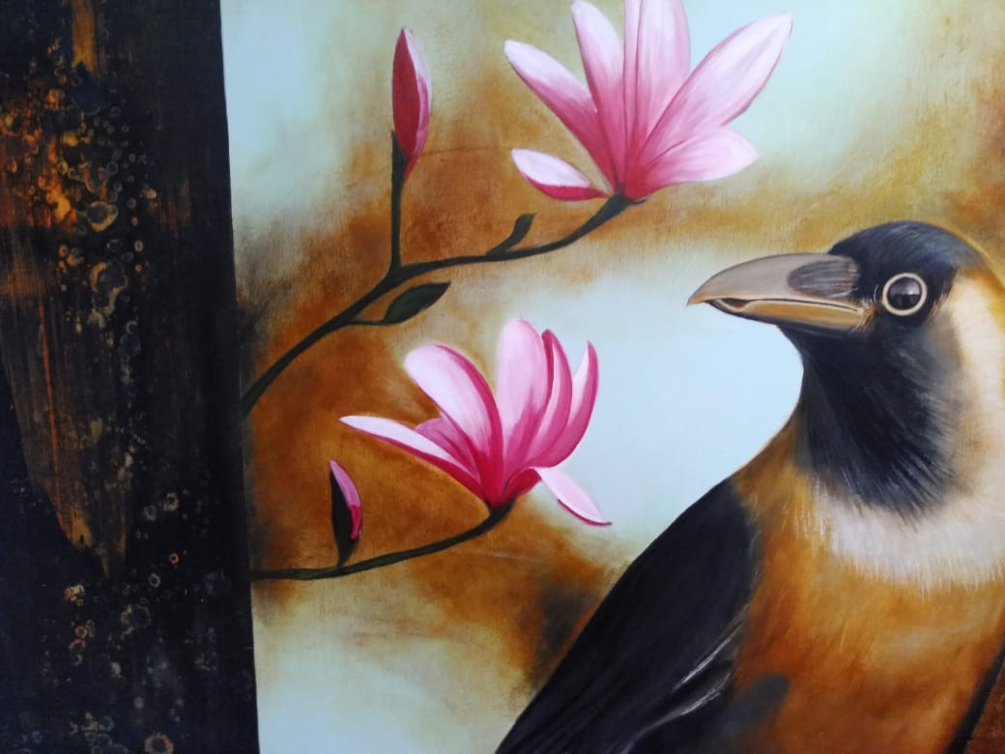
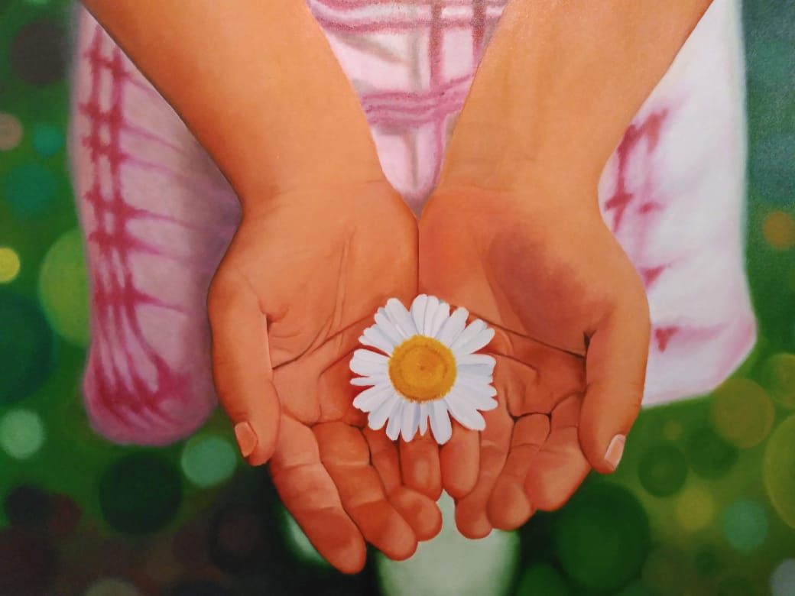
Potential Applications
Social Networking Sites (Instagram etc.)
Filters in Instagram can be extended to incorporate this concept
You can give your image style of famous painters like Pablo Picaso etc
Filters like:

Slide 7
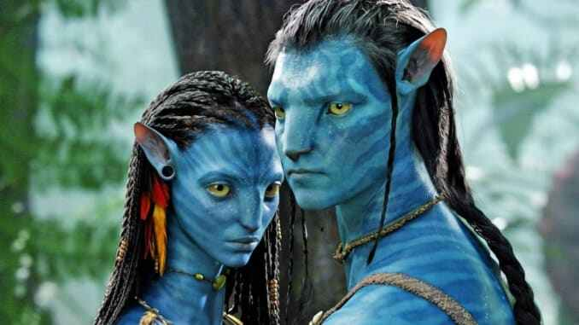
Entertainment World such as animation movies and gaming:
Actors like in the movie Avatar can shoot without slightest makeup
Then using our work we can make them appear as if they shooted with makeup
Fig. : Actors can shoot without make-up

Slide 8
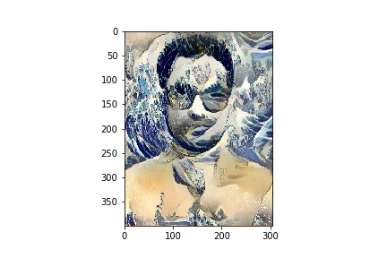
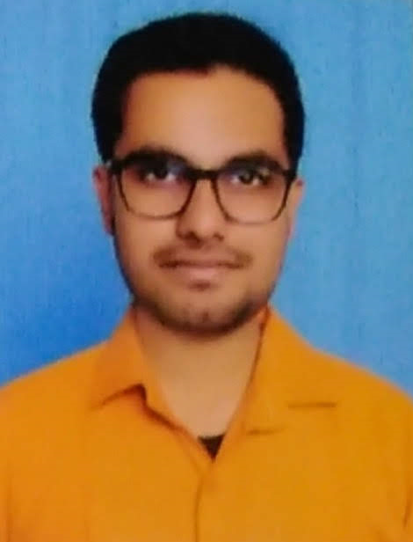
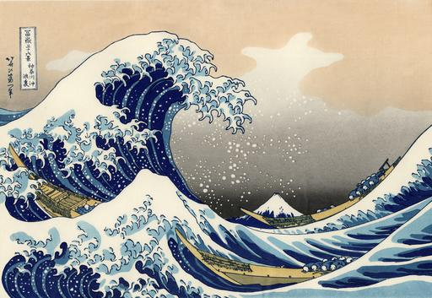
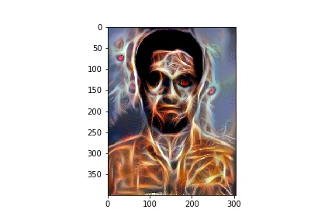
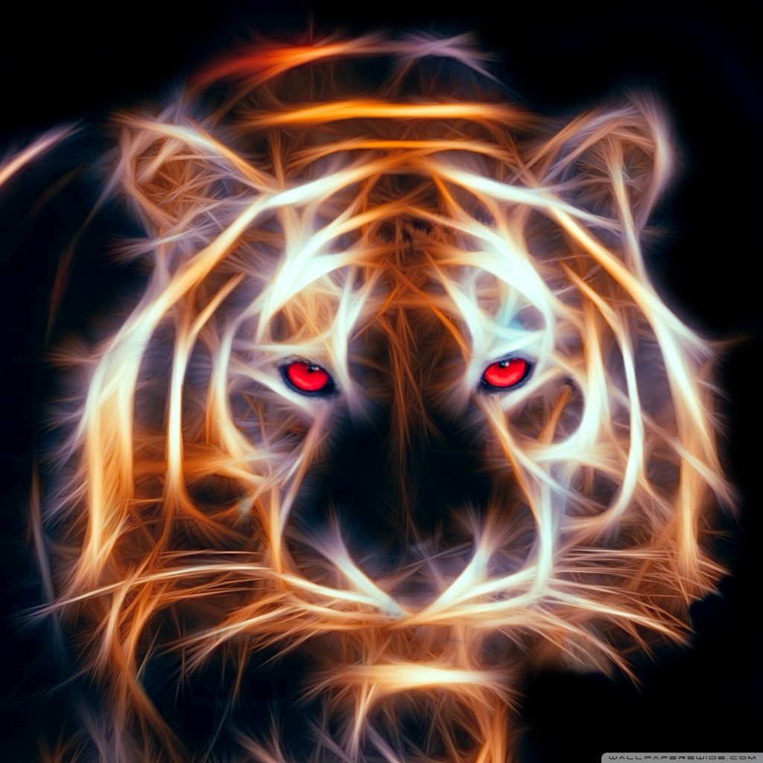
Mobile App Industry:
Third-party apps can be developed to be used for instagram filters
Style Image 1
Fig. : Two Totally Different Outputs
Original Image : Gaurav
Style Image 2

Slide 9
Introduction
Formally Style Transfer is:
For Video:
constructing image X such that X matches the style of style image A and content of original image P at the same time by optimizing the pixel values of X
For Audio :
creating a new audio from two input audio
E.g., background music can be modified by mixing style of other audio

Slide 10
Literature Review (Early Works)
Gatys et al:
used vgg-19, a CNN pretrained on ImageNet dataset by Stanford Vision Lab of Stanford University
Used average pooling
Did not used fully connected (FC) layer

Slide 11
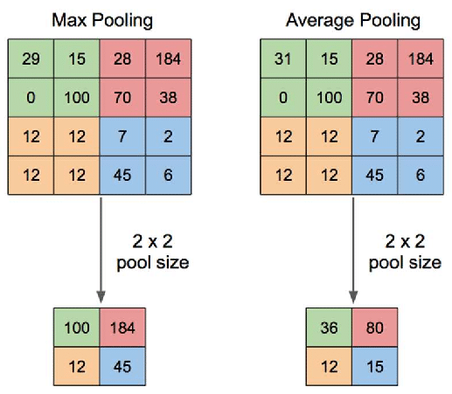
Pooling

Slide 12
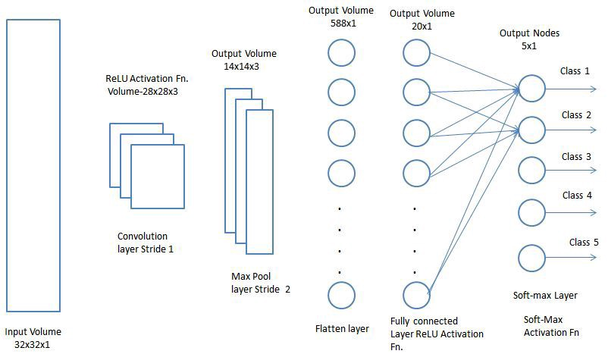
FC Layer

Slide 13
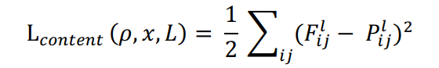
Losses in Style Transfer
Content Loss
Let us select a hidden layer (l) in VGG-19 to calculate the content loss. Let p: original image and x: generated image. Let P_{l} and F_{l} denote feature representations of the respective images corresponding to layer l
Then content loss is:

Slide 14
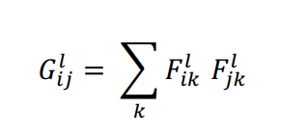
Style Loss
Style
Intuitively, it is texture information and local color scheme
Mathematically, it is the correlation between filters at a given layer l which involves the dot product between the vectorized feature maps i and j at layer l
The matrix thus obtained is called Gram Matrix (G)
Note:
Two channels are correlated if and only if the value of dotproduct across the activation of two filters is larger than appropriate threshold

Slide 15
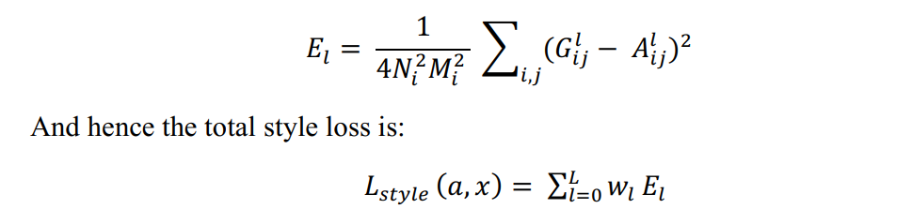
Style loss is the square of difference between the Gram Matrix of the style image with the Gram Matrix of generated Image
Let A_{l} and G_{l} denote respective style representations in layer l. The contribution of layer l to total style loss is
Here, w_{l} are corresponding to weighting factors of the contribution of each layer to the total loss

Slide 16
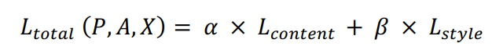
Why Losses are Important?
We start by initializing X to some random values (called noise)
The process of optimizing pixel values includes two tasks at the same time - minimize both the content loss(L_{content}) and style loss(L_{style}) by using backpropagation
Total loss (as seen) boils down to :
Here, α and β are hyper-parameters that need to be set

Slide 17
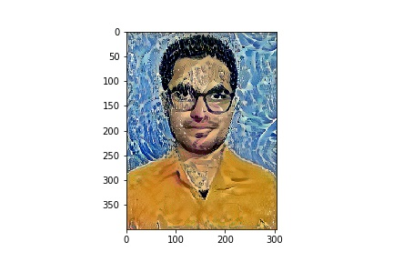
The ratio α/β :
A large α/β ratio means more emphasis is on content of P in X
A small α/β ratio means more emphasis is on style of A in X
Fig. : Large Ratio: Small Ratio:

Slide 18
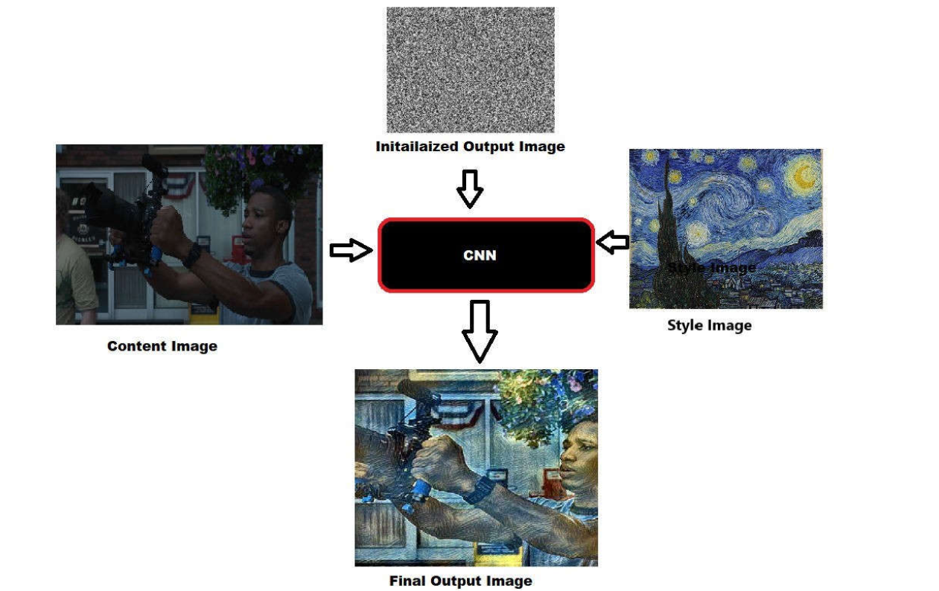
A video is collection of frames which are swapped sequentially at a sufficiently fast rate
So we first obtained the frames of video before applying style.
Next we applied our code to each of the frame and saved the results.
Last thing for Video Style Transfer was to re-attach the frames to form a video
Fig. : Methodology for Video Styling

Slide 19
For Audio Styling
Training of AlexNet is done on spectrograms of instrumental sounds with 3×3 convolution filters and 2×2 max pooling
It has 6 layers in total and Adam optimizer

Slide 20
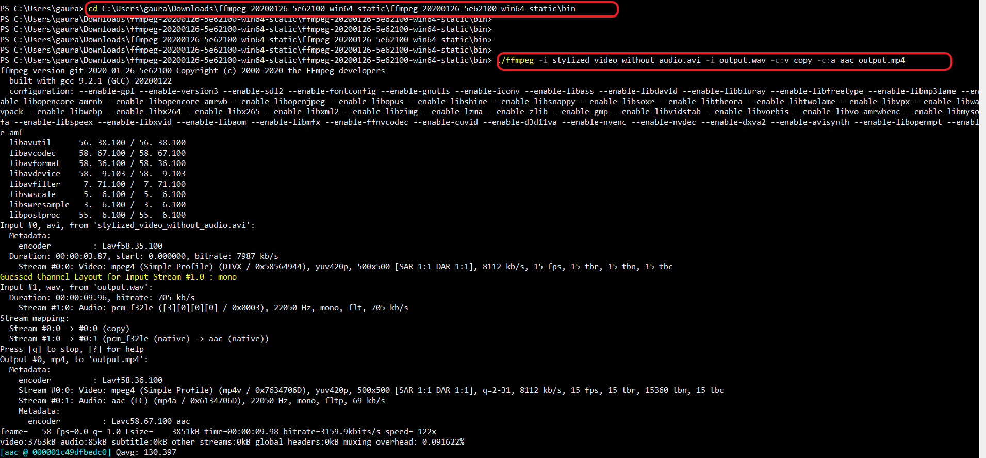
Final Touch...
The last thing to do was to combine generated video and audio. For that we used a software ffmpeg

Slide 21

Original Video (With Audio)

Slide 22

Our Style Image

Slide 23

Our Style Audio

Slide 24
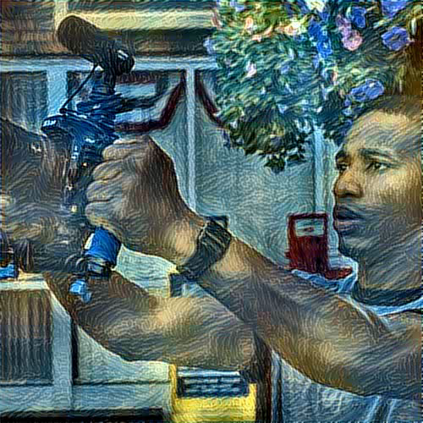
Final Output Video with Audio

Slide 25
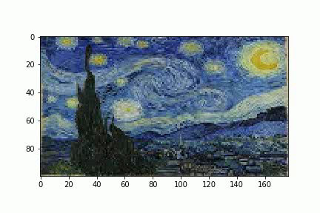
Comparison with Older Methods

Slide 26
Future Directions
The quality of audio may be made more plausible
In our final output the frames appear to be cropped. This can be taken care of

